Slide 1

An AI-Based Web Traffic Monitoring System in Supply Chain Security
IFT525 Introducing AI into CyberSecurity for Information Technology
Hemanth Kumar Guntupalli, Pooja Thalur
04/22/2025

Slide 2

Problem Statement & Its Importance
Enterprises are vulnerable to sophisticated cyber attacks, especially supply chain attacks, where sensitive data is intercepted or rerouted to unauthorized destinations. Traditional security systems often fail to detect these threats in real time, especially when they involve trusted third-party vendors or appear as normal traffic.

Slide 3
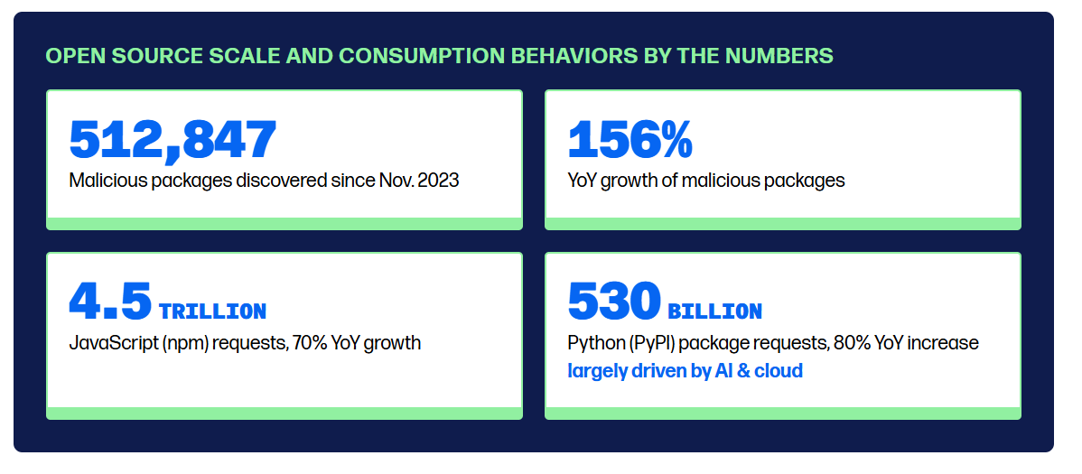
Today, an average software project has 203 dependencies. If a popular app includes one compromised dependency, EVERY BUSINESS that downloads from the vendor is compromised as well, so the number of victims can grow exponentially.
Past year data->
https://www.sonatype.com/state-of-the-software-supply-chain/introduction

Slide 4
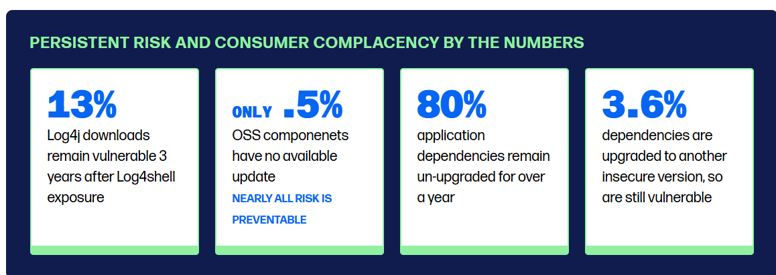

Slide 5
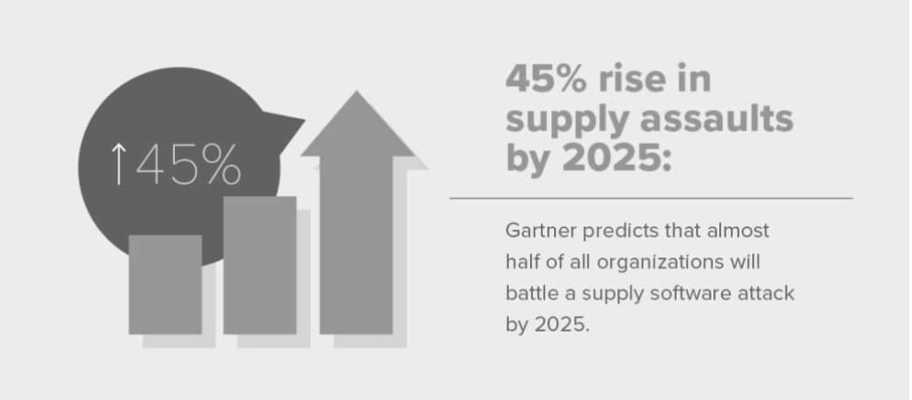
Some stats….
Given the dependent nature of supply chains, we cannot ignore this new menace to software that seems safe. One infection may take an astonishingly short amount of time to spread and wreak havoc. Supply chains will feel the pressure to evolve with the tools they rely on, as more software providers rethink their signed-and-sealed coding architecture.

Slide 6


State of the Field / Literature Review
Numerous studies on software supply chain risk management (NIST C‑SCRM, SBOM analysis) focus on static vulnerability scanning and vendor risk scoring.
Current methods lack real‑time, fine‑grained visibility into encrypted or obfuscated traffic flows, leaving exfiltration channels undetected.
Most AI solutions operate as black boxes, analysts struggle to trust or act on alerts without clear explanations.
Opportunities exist for AI systems that combine flow‑metadata analysis with unsupervised and supervised learning to detect supply‑chain exfiltration in real time.

Slide 7
Current Method | Key Limitation | AI-Driven Opportunity
SIEM / Log Analytics | Rule-based systems are reactive and noisy | AI-based correlation engines can cluster related events, prioritize real threats, and reduce false positives.
Third-Party Risk Scoring | Snapshot-based risk assessments | Continuous behavioral profiling of vendors using AI can detect when “trusted” parties behave abnormally.
Zero Trust | Doesn’t detect data exfiltration or insider misuse | Context-aware AI can detect lateral movement, credential misuse, and suspicious data transfers in real time.
Threat Intelligence | Reactive; depends on known indicators | NLP models can analyze global threat feeds, emails, code commits, and security reports to anticipate emerging threats.
SCA / SBOM | Static and offline; no runtime visibility | AI models can trace software behavior at runtime and detect unexpected interactions with external services.

Slide 8

Spot the differences

Slide 9
Spot the differences
Here are the differences between the two images (Left vs right):
Top left flower – The petal on the left image is full; on the right image, it's partially missing.
Top right corner – One petal is missing from the flower in the right image.
Yellow flower on the left – Present in the right image, but missing in the left.
Butterfly wings – The spot pattern on the butterfly differs slightly between the two.
Red handle of the net – The right image has an extra black ring on the handle that’s missing in the left.
Bottom right white flower – Present in the left image but missing in the right.
Petal near bottom center – The curled petal points differently in each image.
Brown stem near the net's left – In the left image it’s more curved; in the right it’s straighter.
Hole in the net – One of the holes near the top of the net is missing in the right image.
Stem to the left of the net – A tiny bud is missing in the right image.

Slide 10

PROPOSED SOLUTION
Modular design leveraging Unsupervised Machine Learning and Behavioral Analytics.
Federated Learning integration for third-party behavioral modeling
Explainable AI (XAI) module for human analyst verification.

Slide 11
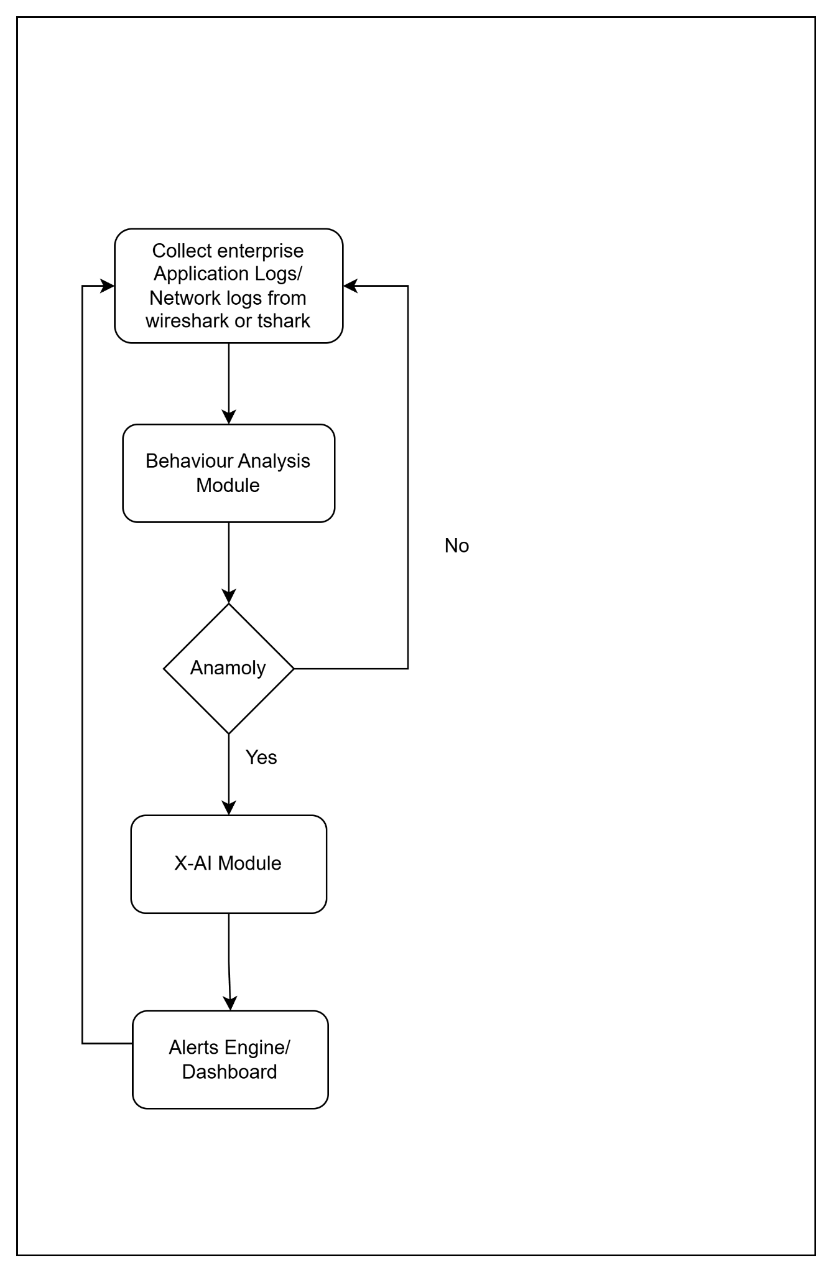
Process Flow

Slide 12

TECHNICAL DETAILS & ARCHITECTURAL DIAGRAM

Slide 13
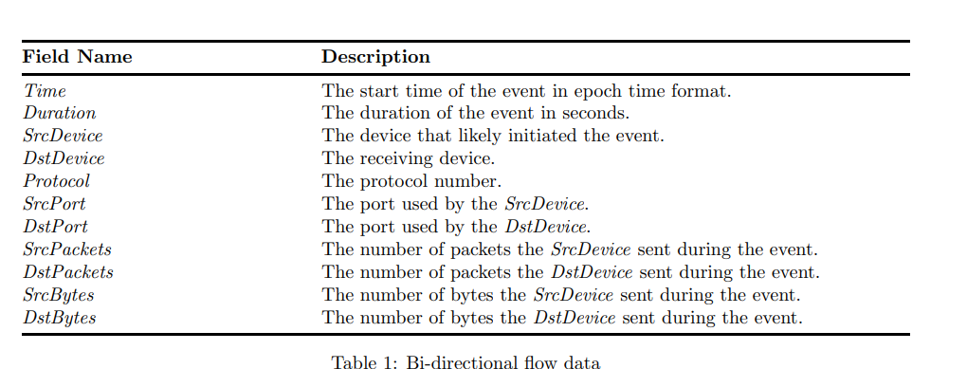
Data Flow & Ingestion
Sources: Web application logs, internal data, and external security reports.
Real-time data streaming to gather information instantly.
Raw data is converted into forms like csv, keeping only the data required

Slide 14
Processing, Storage
Processing: Real-time analysis using tools like Apache Kafka and Spark for quick anomaly detection.
Storage: Stores results securely in databases/files and cloud storage
Interface
Web dashboards for monitoring alerts.
APIs for automated system interactions.
Scalability & Security measures
Federated Learning: Share only model updates, never raw vendor data
Integrate adversarial training

Slide 15
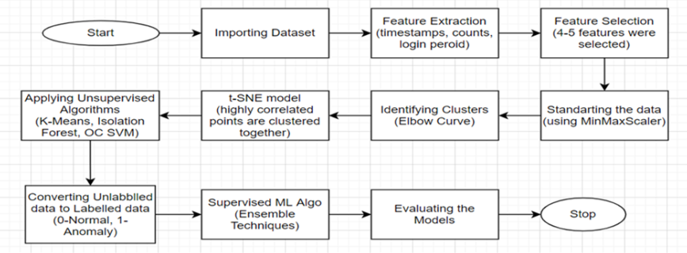
Anomaly Detection Model
After this an explainable AI can be used to generate transparent results using LIME, SHAP, ELI5, etc. libraries in Python

Slide 16
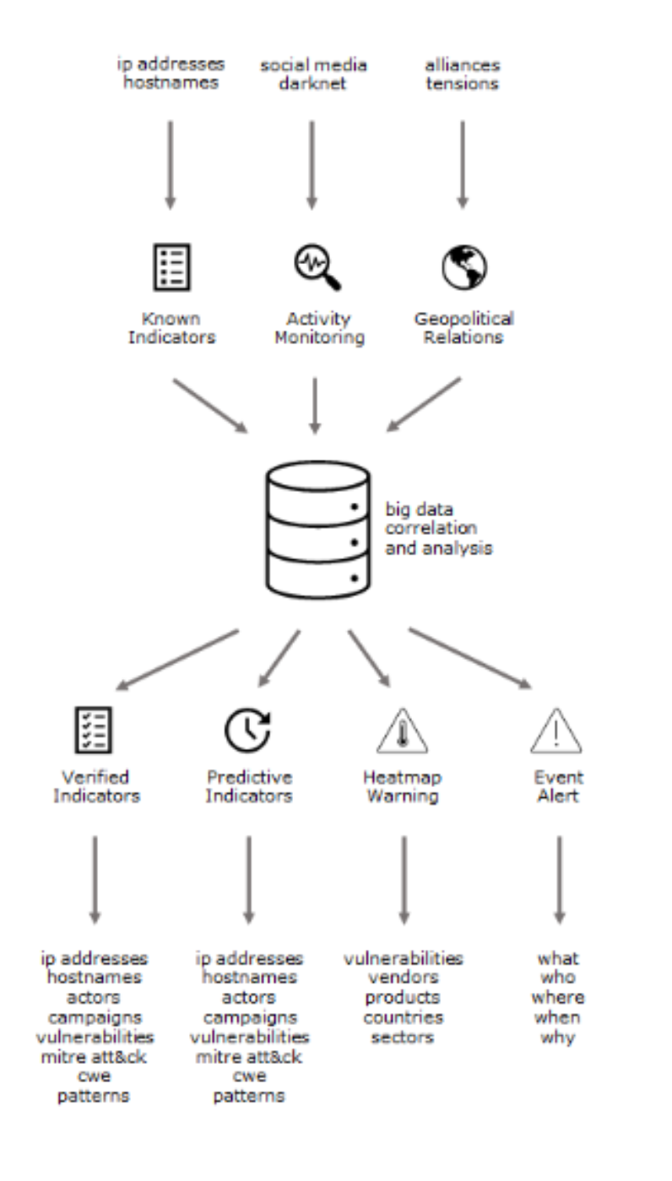
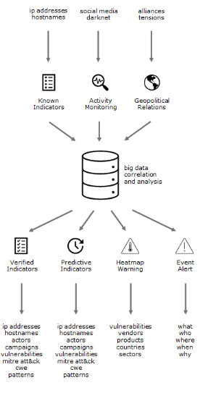
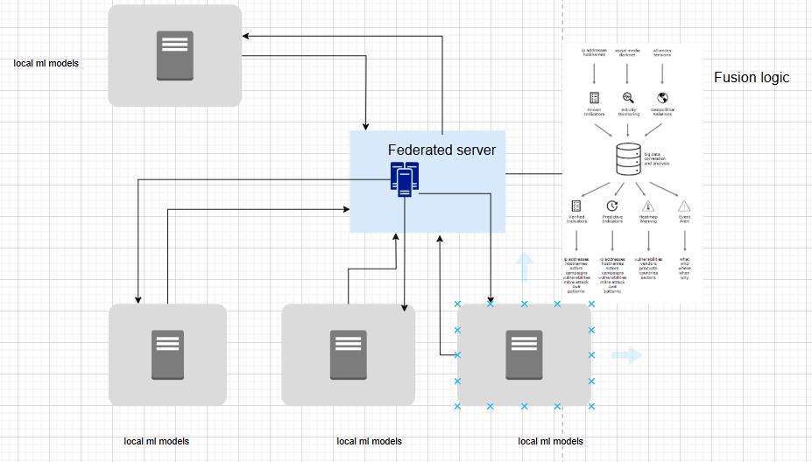

Slide 17
Key anomaly patterns the system can uncover:
Unusual Traffic Destinations
Timing & Volume Deviations
Authentication & Access Anomalies
Protocol & Flow‐Metadata Shifts
File & Software Integrity Abnormalities
Uncharacteristic API Calls
Behavioral Drift Over Time
Cross‐Correlation Flags

Slide 18
Validation & Ethical Design Considerations

Slide 19
Accuracy: How well the system correctly identified true anomalies.
Precision/Recall: To assess false positives vs. actual threat capture.
F1 Score: Balance of precision and recall.
Latency: Time from event detection to alert.
Scalability: How well the system handles large volumes of logs.
Explainability Rating & Feedback loop (via analyst survey): How clear and actionable the AI alert explanations were.

Slide 20
Ethical Considerations
PRIVACY - Using data minimization, anonymization. Using Federated learning
TRANSPARENCY - Avoid black-box models for final decisions without justification. Using Explainable AI.
BIAS AND FAIRNESS - Because of skewed data. Rotate training data sources and ensure diversity
Human-in-the-Loop Design
Compliance & Legal Considerations

Slide 21

DISCUSSION & KEY FIGURES

Slide 22
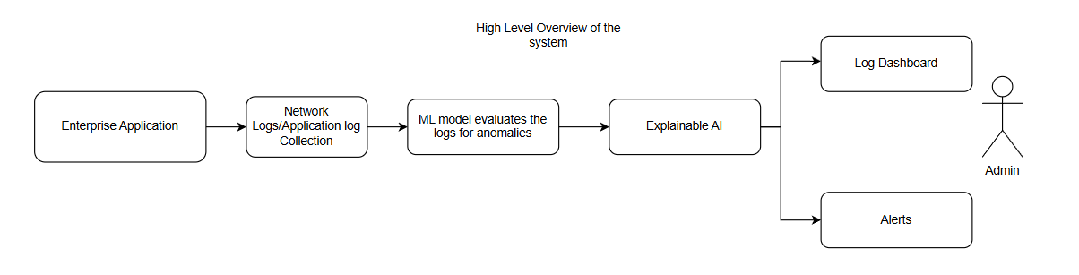

Slide 23
Conclusion & Future Work
By continuously profiling each vendor’s normal network and application behavior - applying AI to detect deviations even in encrypted traffic - the system uncovers stealthy supply‑chain exfiltration that traditional tools miss. Augmented with SHAP/LIME explanations, it delivers clear alerts and automated response actions, enabling rapid containment and reducing breach dwell time.
Future Work:
Scanning of code repositories, CI/CD pipelines, and dark‑web sources - feeding new indicators/features.
Feedback mechanisms so analysts can correct false positives and drive continuous model improvement.

Slide 24

References
https://www.sciencedirect.com/science/article/pii/S2665917422001799
https://www.sciencedirect.com/science/article/pii/S2772662225000013

Slide 25
THANK YOU!
FOR YOUR ATTENTION

